Slide 1
Applied Soft Biometric Extraction
Jared Vue and Viet Ha

Slide 2
Core Concepts
Apply soft biometric extraction for authentication
Use of facial detection and Convolutional Neural Networks (CNN)
Combined facial landmark model and human pose estimation model
Create a model for facial landmark detection with human pose estimation
Combined facial landmark model and human pose estimation model
Analysis of results
Performance Evaluation
Mean Squared Error

Slide 3
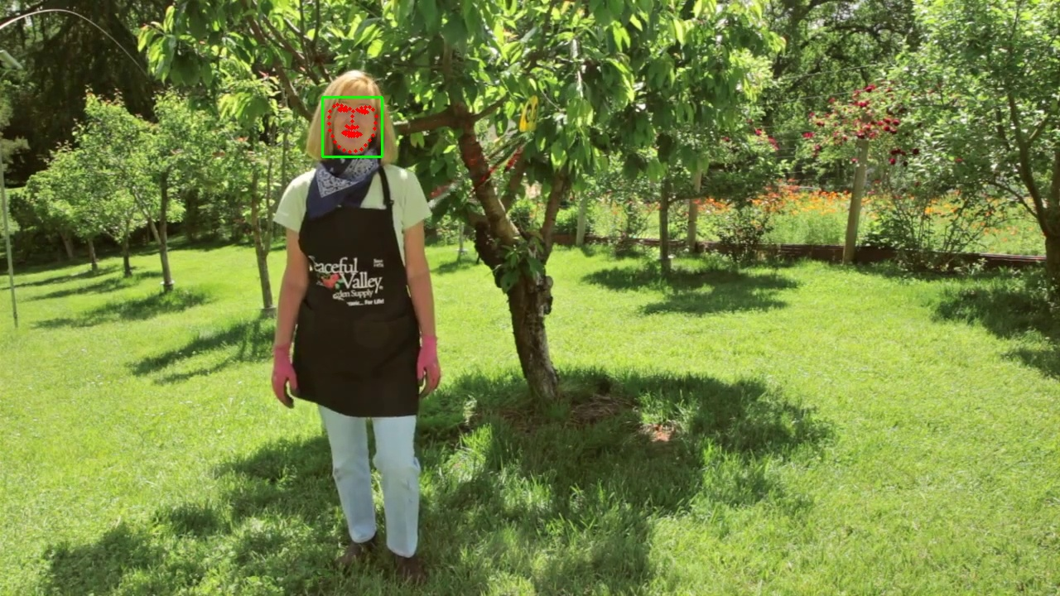
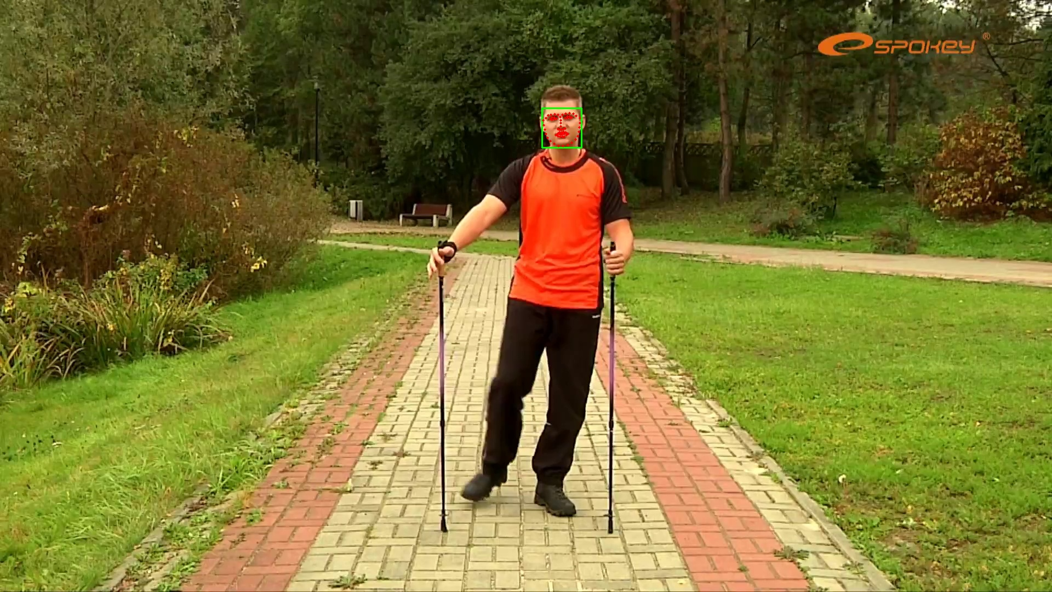
Algorithms/Implementations
Facial Landmark Model:
For data preprocessing, we converted the images to grayscale
Uses a pre-trained face detector from dlib for face identification
Uses a pre-trained facial landmark predictor from dlib to extract 68 facial landmarks
Extracted facial landmarks are then written into a CSV file and the original image is annotated with bounding boxes.

Slide 4
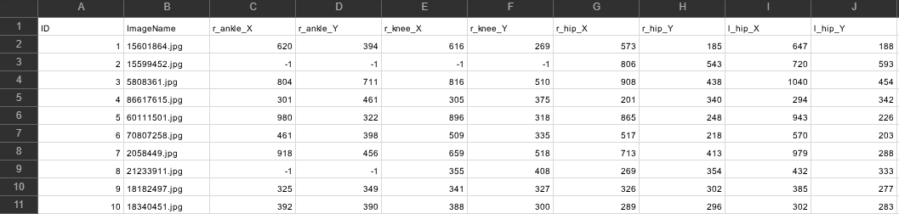
Human Pose Estimation Model:
Loaded our images we used TensorFlow Keras
Converted images to NumPy arrays and normalized pixel values to the range [0, 1]
Used a simple CNN model using TenserFlow Keras API that consists of convolutional layers, max-pooling, flattening and dense layers
The training process is visualized by plotting the training and validation loss over epochs

Slide 5
Results/Evaluation
Both of our trained models are used to make predictions on the data
The MSE measures the averaged squared difference between the predicted values and actual values.
The lower the MSE error the better the model's predictions are with the actual values.

Slide 6
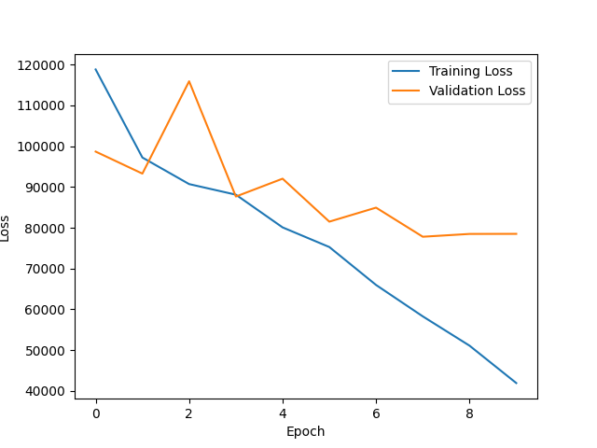

Slide 7
